Slide 1
Modelling Plasticity
Meha Jadhav
Camp 2022

Slide 2
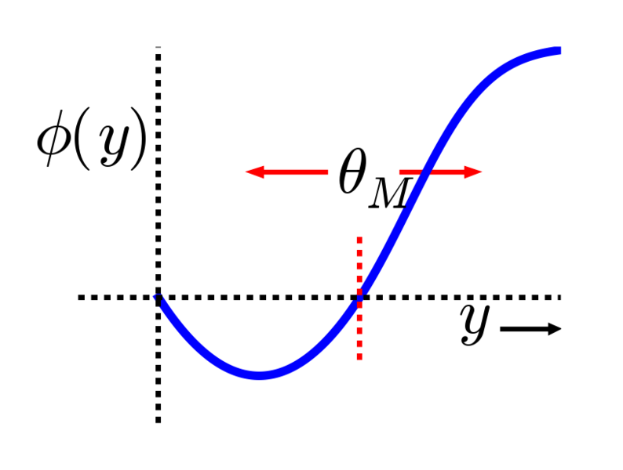
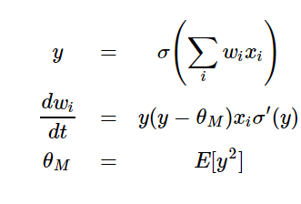
Bidirectional Plasticity and the BCM Theory
Φ(y): modification function
θ_{M}: Modification threshold
y: postsynaptic activity
X: presynaptic activity
Bienenstock, E. L., Cooper, L. N, and Munro, P. W. (1982). J Neuro

Slide 3
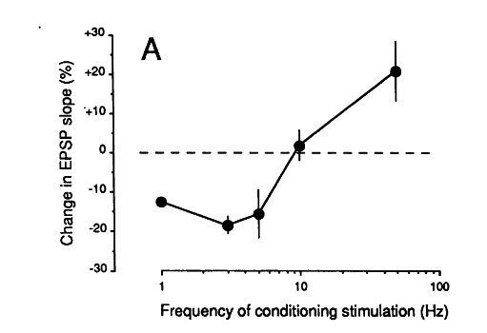
Experimental validation of BCM theory
Dudek and Bear (1992). PNAS

Slide 4
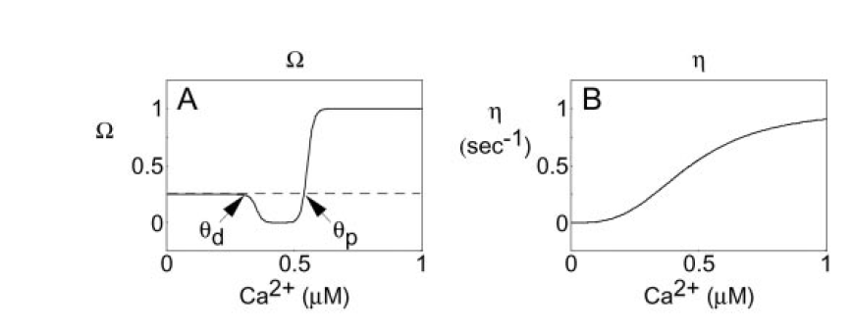

BCM theory and calcium
η: learning rate
Ω: calcium dependent modification function
Shouval, Bear and Cooper (2002). PNAS

Slide 5
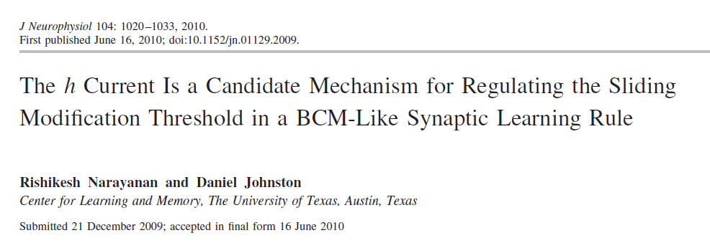
How to make a model of BCM theory?
Postsynaptic cell
NMDAr
AMPAr
Calcium Dynamics
Weight update rule
Stimulus

Slide 6
How to make a model of BCM theory?
Postsynaptic cell
NMDAr
AMPAr
Calcium Dynamics
Weight update rule
Stimulus

Slide 7
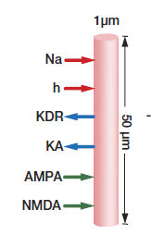
How to make a model of BCM theory?
Postsynaptic cell
Conductance based model of dendrite

Slide 8
How to make a model of BCM theory?
Postsynaptic cell
NMDAr
AMPAr
Calcium Dynamics
Weight update rule
Stimulus

Slide 9
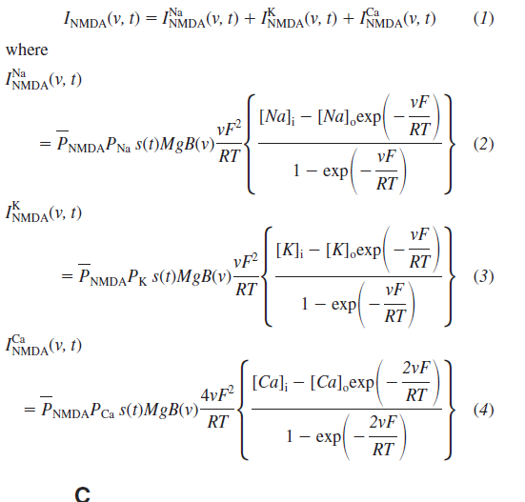
How to make a model of BCM theory?
2. NMDAr
ghknmda.mod
BREAKPOINT {
SOLVE state METHOD cnexp
P=B-A
mgb = mgblock(v)
ina = P*mgb*ghk(v, nai, nao,1)*Area ica = P*10.6*mgb*ghk(v, cai, cao,2)*Area ik = P*mgb*ghk(v, ki, ko,1)*Area inmda = ica + ik + ina
}
DERIVATIVE state {
A' = -A/taur
B' = -B/taud
}

Slide 10
How to make a model of BCM theory?
Postsynaptic cell
NMDAr
AMPAr
Calcium Dynamics
Weight update rule
Stimulus

Slide 11
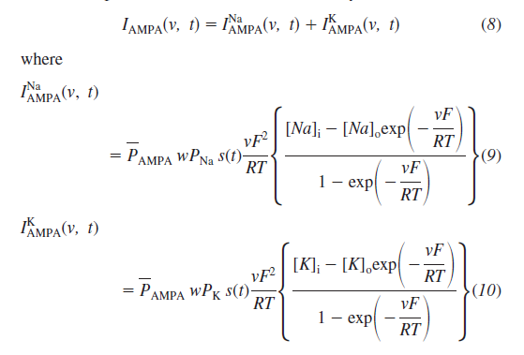
How to make a model of BCM theory?
3. AMPAr
ghkampa.mod
BREAKPOINT {
SOLVE state METHOD cnexp
P=B-A
ina = P*w*ghk(v, nai, nao,1)*Area ik = P*w*ghk(v, ki, ko,1)*Area iampa = ik + ina
}
DERIVATIVE state {
lr=eta(cai)
w' = lr*(Omega(cai)-w)
A' = -A/taur
B' = -B/taud
}

Slide 12
How to make a model of BCM theory?
Postsynaptic cell
NMDAr
AMPAr
Calcium Dynamics
Weight update rule
Stimulus

Slide 13
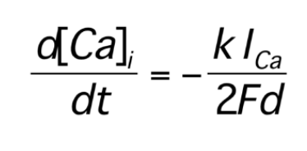
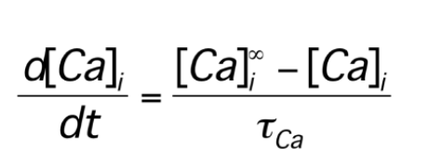
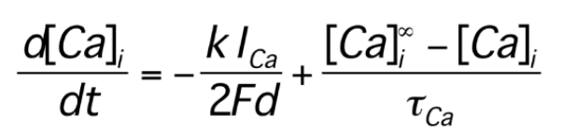
How to make a model of BCM theory?
4. Calcium dynamics
Influx through various channels
Efflux via pumps, buffers etc
Combining them we get

Slide 14
How to make a model of BCM theory?
Postsynaptic cell
NMDAr
AMPAr
Calcium Dynamics
Weight update rule
Stimulus

Slide 15
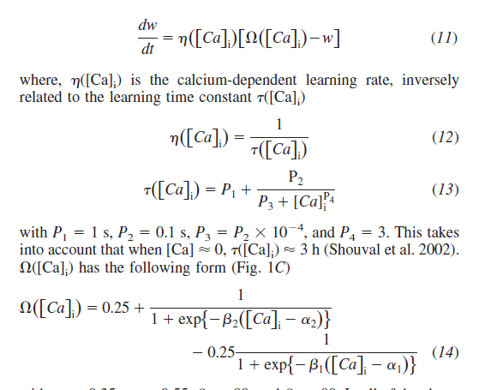
How to make a model of BCM theory?
5. Weight update rule
ghkampa.mod
DERIVATIVE state {
lr=eta(cai)
w' = lr*(Omega(cai)-w) A' = -A/taur
B' = -B/taud
}

Slide 16
How to make a model of BCM theory?
Postsynaptic cell
NMDAr
AMPAr
Calcium Dynamics
Weight update rule
Stimulus

Slide 17
How to make a model of BCM theory?
6. Stimulus
900 spikes of frequency from1 to 25 Hz
objref s
s = new NetStim(0.5)
s.interval=intrvl // ms (mean) time between spikes
s.number=nmbr // (average) number of spikes
s.start=tsyn // ms (mean) start time of first spike
s.noise=0 // range 0 to 1. Fractional randomness
for (i=1; i<=25; i+=1) { s.interval=1000/I
}

Slide 18
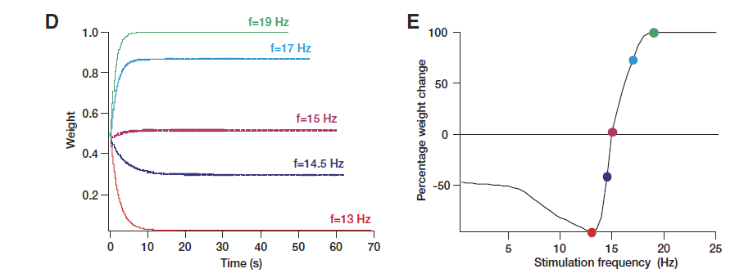
What does the model do?

